Slide 1
Module 6 Week 1 – Hadoop

Slide 2
Hadoop Roadmap
Week 1
Big Data Discussion
Introduction to MapReduce, Hadoop and YARN
Map Reduce Programming Model
YARN
Hadoop Distributed File System (HDFS)
Hadoop Ecosystem
Apache Hbase
Query Engines
More on MapReduce
Hadoop in cloud computing
Lab 1

Slide 3
Big Data Discussion
Phenomenal growth in data generation
Social media
Sensors
Communications networks and satellite imagery
User-specific business data
“Big data” refers to massive amounts of data
Exceeds the typical reach of a DBMS
Big data analytics

Slide 4
Big Data Discussion
Types of analytics applications
Descriptive and Predictive Analytics
Prescriptive Analytics
Social Media Analytics
Entity Analytics
Cognitive Computing

Slide 5
What is Big Data?
Big data ranges from terabytes (10¹² bytes) or petabytes (10¹⁵ bytes) to exobytes (10¹⁸ bytes)
Volume
Refers to size of data managed by the system
Velocity
Speed of data creation, ingestion, and processing
Variety
Refers to type of data source
Structured, unstructured

Slide 6
What is Big Data? (cont’d)
Veracity
Credibility of the source
Suitability of data for the target audience
Evaluated through quality testing or credibility analysis

Slide 7
Introduction to MapReduce, Hadoop and YARN
Hadoop
an open source software platform for distributed storage and distributed processing of very large data sets on computer clusters built from commodity hardware

Slide 8
Introduction to MapReduce, Hadoop and YARN
Why Hadoop?
Disk seek times
Hardware failure
Processing times

Slide 9
Introduction to MapReduce, Hadoop and YARN
Core components of Hadoop
MapReduce programming paradigm
Hadoop Distributed File System (HDFS)
Apache Hadoop YARN (Yet Another Resource Negotiator)
Hadoop originated from quest for open source search engine
Google published GFS and MapReduce papers in 2003-2004
Developed by Cutting and Carafella in 2004
Cutting joined Yahoo in 2006 (Nutch)
Yahoo spun off Hadoop-centered company in 2011
Tremendous growth

Slide 10
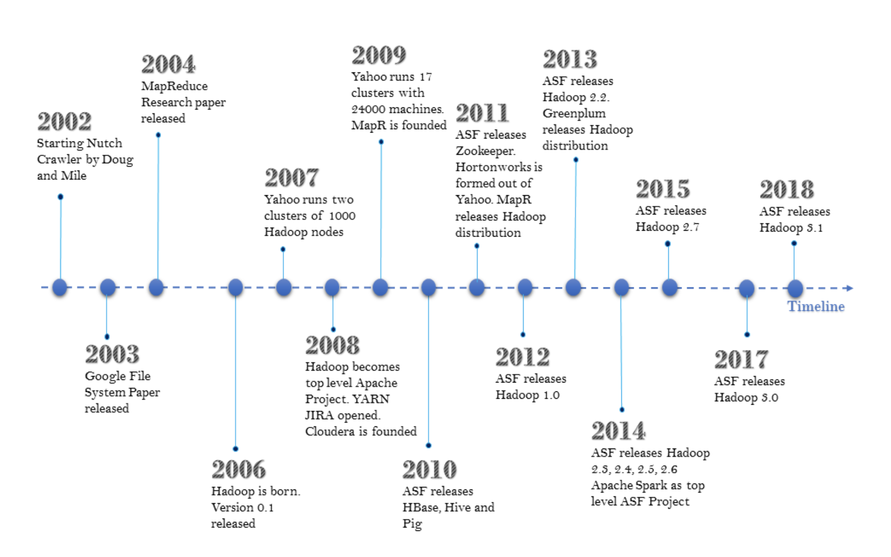

Slide 11
Introduction to MapReduce, Hadoop and YARN
Hadoop Flavors
Apache
Hortonworks
Cloudera
MapR
IBM

Slide 12
Introduction to MapReduce, Hadoop and YARN
MapReduce
Developed by Dean and Ghemawat at Google in 2004
Programming style: map and reduce tasks
Automatically parallelized and executed on large clusters of commodity hardware
Allows programmers to analyze very large datasets
Underlying data model assumed: key-value pair

Slide 13
Introduction to MapReduce, Hadoop and YARN
Typical Big Data Problem
Iterate over a large number of records
Extract something of interest from each
Shuffle and sort intermediate results
Aggregate intermediate results
Generate final output

Slide 14
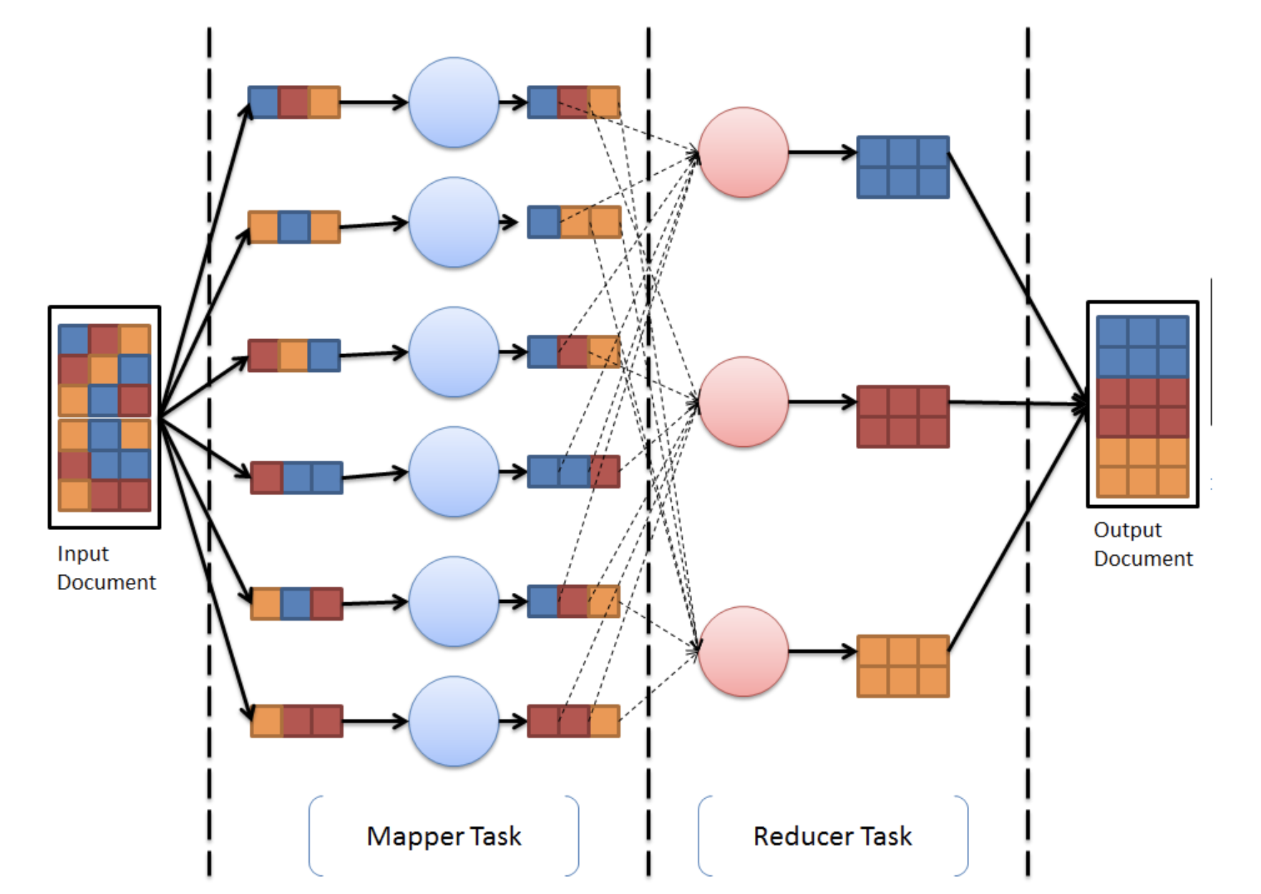

Slide 15
The MapReduce Programming Model
Map
Generic function that takes a key of type K1 and value of type V1
Returns a list of key-value pairs of type K2 and V2
Reduce
Generic function that takes a key of type K2 and a list of values V2 and returns pairs of type (K3, V3)
Outputs from the map function must match the input type of the reduce function

Slide 16
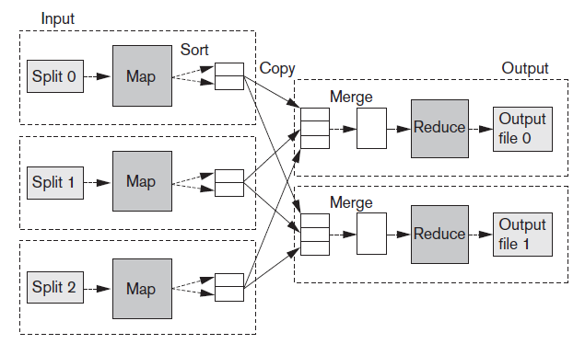
The MapReduce Programming Model

Slide 17
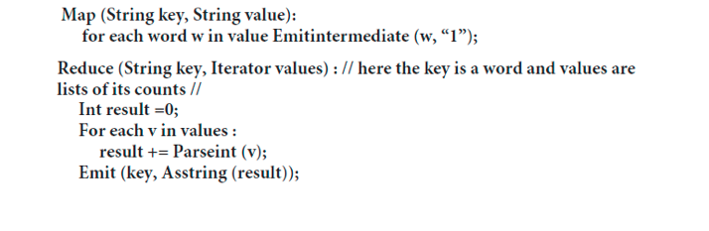
The MapReduce Programming Model
MapReduce example
Make a list of frequencies of words in a document
Pseudocode

Slide 18
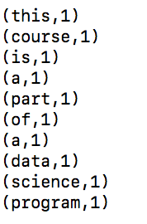
The MapReduce Programming Model
Mapper Phase Execution
This course is a part of a data science program

Slide 19
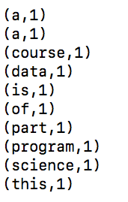
The MapReduce Programming Model
Shafel Phase Execution
This course is part of data science program

Slide 20
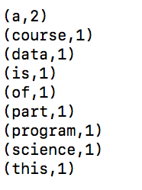
The MapReduce Programming Model
Reduce Phase Execution
This course is part of data science program

Slide 21
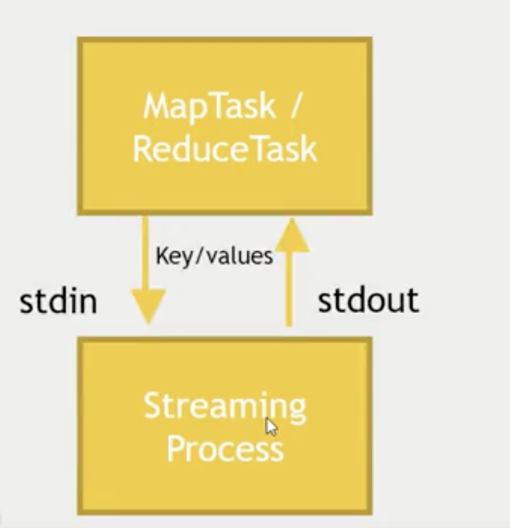
The MapReduce Programming Model
Hadoop is written in Java
Java MapReduce code is “native”
What about non-Java?
Python, Shell, Perl, R
STREAMING
Python, Shell, Perl, R

Slide 22
The MapReduce Programming Model
Hadoop releases
1.x features
Continuation of the original code base
Additions include security, additional HDFS and MapReduce improvements
2.x features
YARN (Yet Another Resource Navigator)
A new MR runtime that runs on top of YARN
Improved HDFS that supports federation and increased availability

Slide 23
The MapReduce Programming Model
Hadoop releases
3.x features
Erasure Code (EC) is one of the major features
Changes the way HDFS stores data blocks
YARN schedule has been improved
Application Timeline Service v2
Supports multiple instances of readers and writers

Slide 24
YARN – Yet Another Resource Navigator
YARN
Started in Yahoo
System that manages the resources of your computer cluster
Decides what gets to run tasks and when
Decides which resources are available for work

Slide 25
YARN – Yet Another Resource Navigator
YARN
Introduced in Hadoop 2
Separates the problem of managing resources on your cluster from MapReduce
Enabled development of MapReduce alternatives (Spark, Tez) built on top of YARN

Slide 26
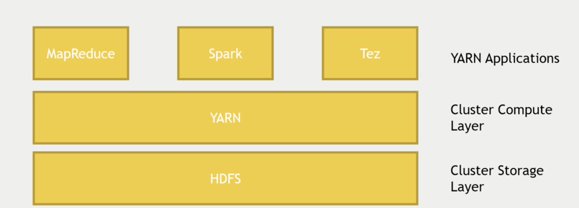
YARN – Yet Another Resource Navigator

Slide 27
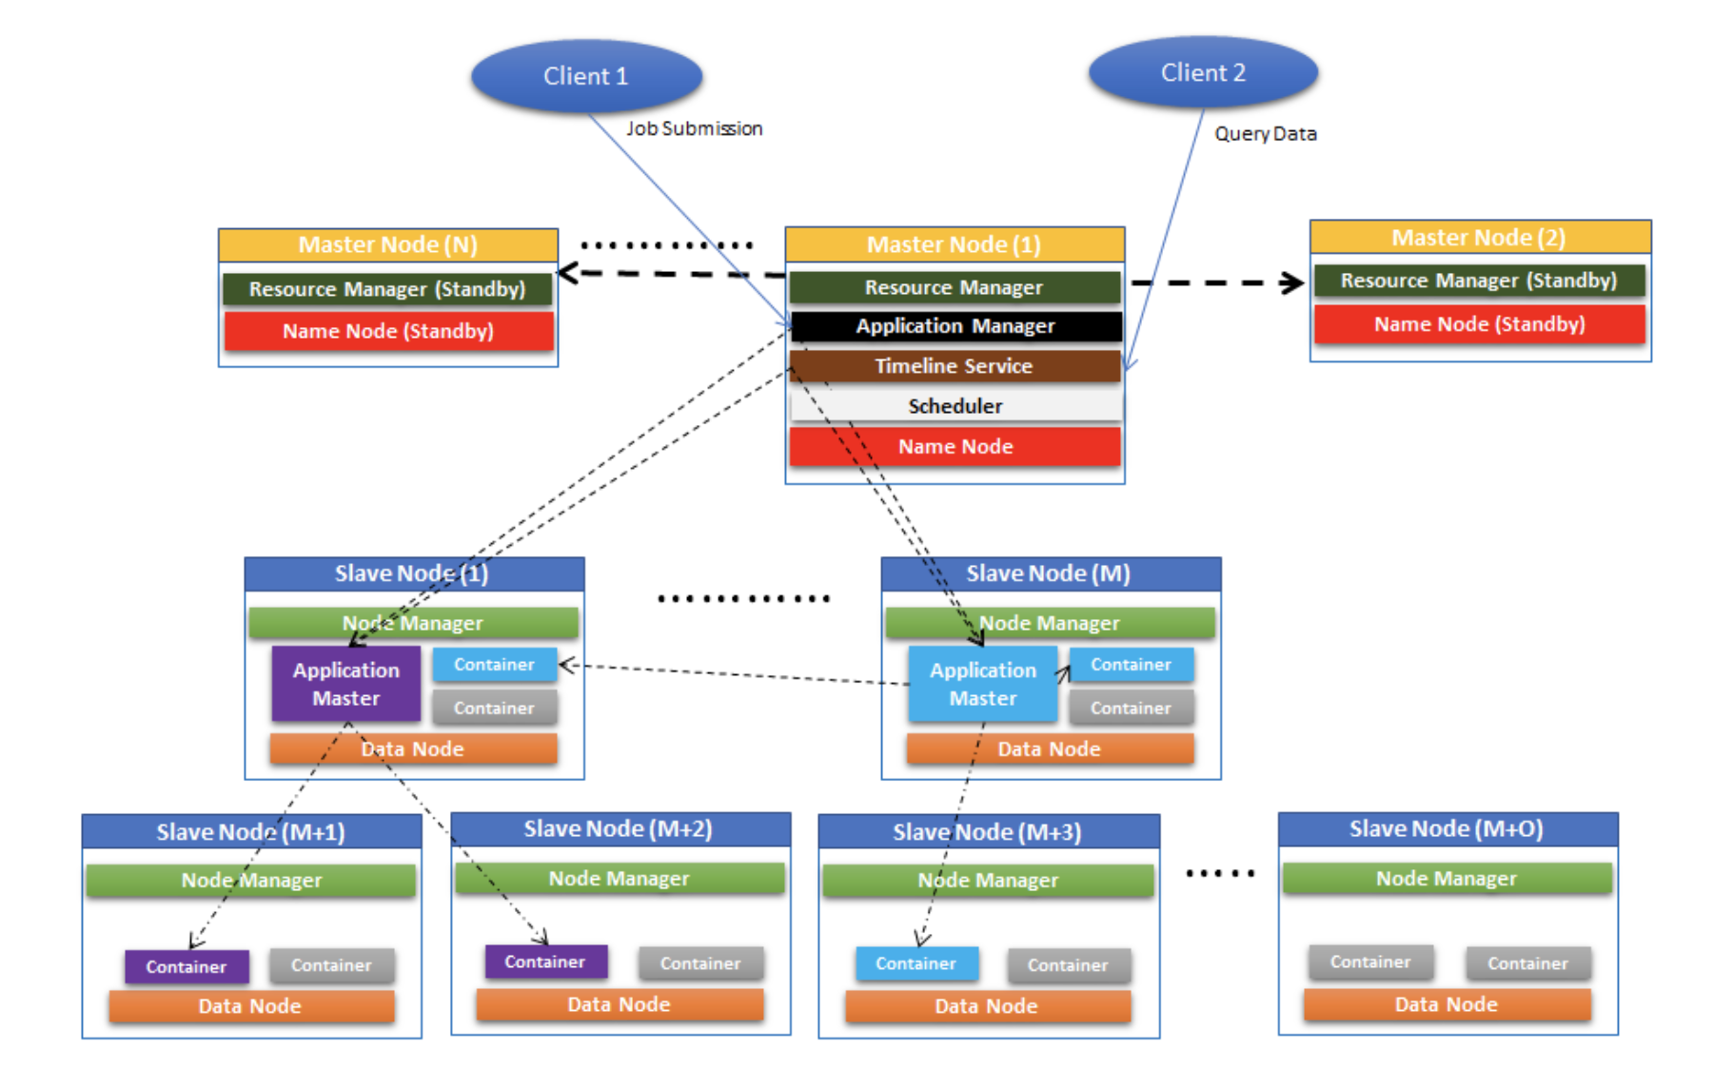

Slide 28
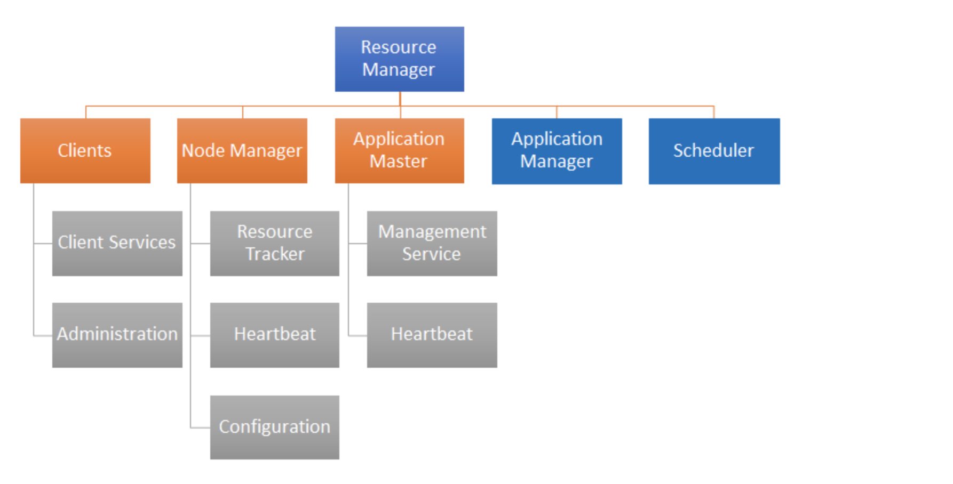
How Apache Hadoop Works – Resource Manager

Slide 29
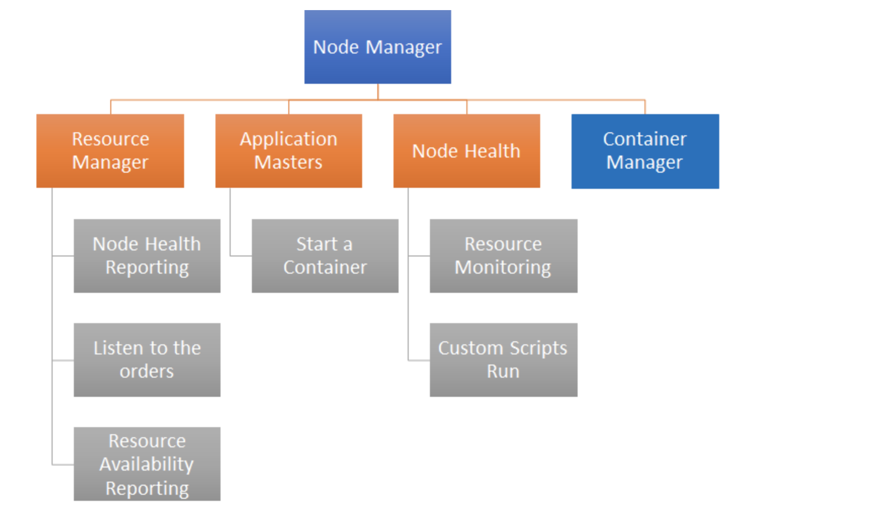
How Apache Hadoop Works – Node Manager

Slide 30
How Apache Hadoop Works – Name Node
NameNode
Maintains image of the file system
Serves as single point of coordination on HDFS data
Works as registry to maintain data blocks spread across the cluster
Serves as heartbeat mechanism for Data Nodes

Slide 31
How Apache Hadoop Works – Data Node
Data Node
Responsible for storing application data
Acts as a slave and is controlled by Name Node
Responsible for storing/retrieving data blocks when requested through Name Node.

Slide 32
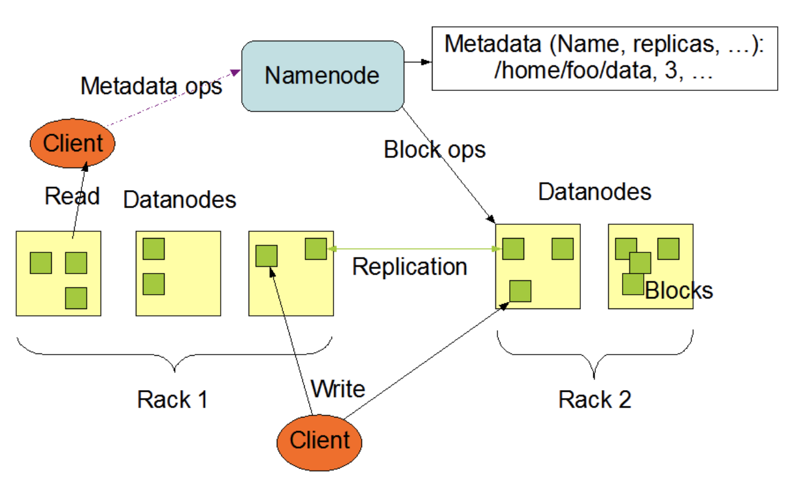
How Apache Hadoop

Slide 33
Hadoop Distributed File System (HDFS)
HDFS
File system component of Hadoop
Designed to run on a cluster of commodity hardware
Patterned after UNIX file system
Provides high-throughput access to large datasets
Stores metadata on NameNode server
Stores application data on DataNode servers
File content replicated on multiple DataNodes

Slide 34
Hadoop Distributed File System (HDFS)
HDFS design assumptions and goals
Hardware failure is the norm
Batch processing
Large datasets
Simple coherency model
HDFS architecture
Master-slave
Decouples metadata from data operations
Replication provides reliability and high availability
Network traffic minimized

Slide 35
How to use HDFS?
Command-line interface
User Interface (Ambari)
HTTP/HDFS Proxies
Java interface
NFS Gateway

Slide 37
The Hadoop Ecosystem
Related projects with additional functionality
Pig and Hive
Provides higher-level interface for working with Hadoop framework
Pig – platform for creating data processing programs that run on Hadoop (Pig Latin has SQL-similar syntax, can perform MapReduce jobs)
Hive – provides SQL-like language for working on data.

Slide 38
The Hadoop Ecosystem
Apache Ambari
Web interface to view and control Hadoop cluster
Hortonworks solution (Cloudera Manager from Cloudera)
Provides a view of the cluster, lets us visualize it
Can execute Hive queries or import databases into Hive
Can execute Pig queries

Slide 39
The Hadoop Ecosystem
Mesos
Alternative to YARN
Another resource negotiator
Originated from Twitter
Not part of Hadoop

Slide 40
The Hadoop Ecosystem
Spark
One of the most popular technologies in Hadoop ecosystem
Sits on top of YARN or Mesos
Can write Map Reduce queries in Python, Java or Scala programming language (preferred)
Can handle SQL queries, machine learning algorithms
Can handle streaming data in real time

Slide 41
The Hadoop Ecosystem
TEZ
Similar to Spark, uses some of the same techniques
Based on directed acyclic graphs (DAGs) to process jobs
Eliminates unnecessary steps
Minimizes dependencies and runs tasks in parallel
Usually used together with Hive to accelerate it

Slide 42
The Hadoop Ecosystem
Apache STORM
Process streaming data from sensors in real time
Works on individual events instead of micro-batches
Can update your machine learning models or transform data into a database in real time

Slide 43
The Hadoop Ecosystem
Oozie
Tool for running and scheduling periodic Hadoop jobs on the cluster
Can create workflow of different Pig, Map Reduce, Hive tasks
Tie them together into one large workflow
Workflows are specified via XML
Provides web interface to monitor the progress and status of workflows

Slide 44
The Hadoop Ecosystem
Zookeeper
Serves as a coordinator, many other tools rely on it
Sits on the side of your system, keeps track of shared state across cluster
Ensures consistency of data
Delegates work of managing information to individual applications

Slide 45
The Hadoop Ecosystem
Sqoop/Flume/Kafka
Tools for getting data into Hadoop cluster from external sources
Sqoop – connector between Hadoop database and RDBMS
Flume – can transport web logs at large scale to the cluster
Kafka – can collect data from a cluster of PCs, web servers and broadcast it into Hadoop

Slide 46
The Hadoop Ecosystem
Apache HBase
NoSQL column-oriented database
Open-source implementation of BigTable
Uses Hadoop Distributed File System (HDFS) for data storage
Can also use Amazon’s Simple Storage System (S3)
Way to expose data to transactional platform

Slide 47
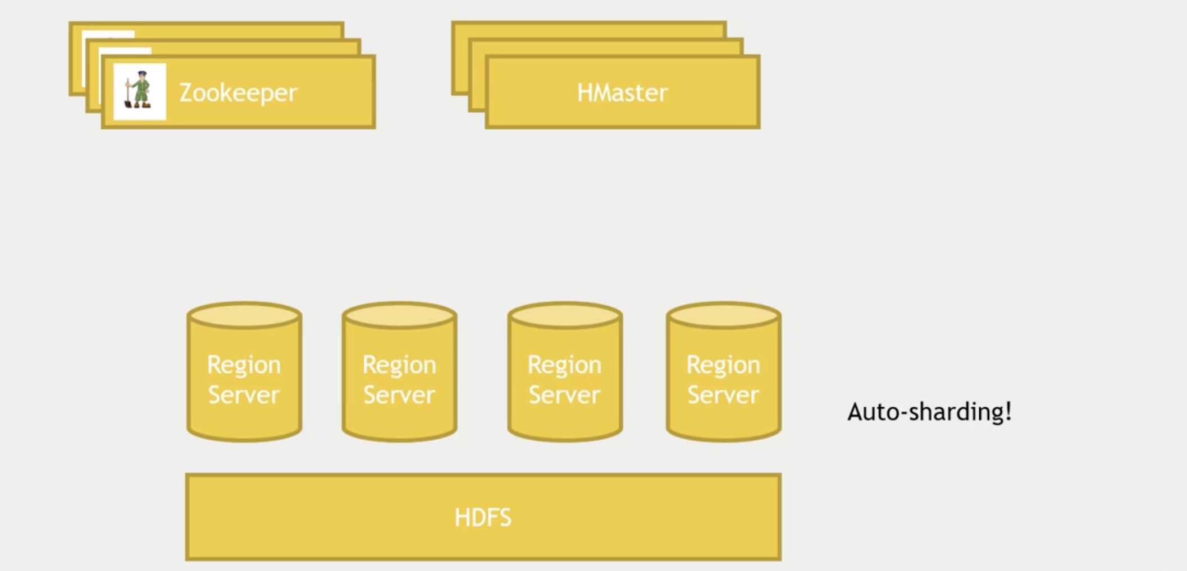

Slide 48
Hbase Data Model and Versioning
Data organization concepts
Namespaces
Tables
Column families
Column qualifiers
Columns
Rows
Data cells
Data is self-describing

Slide 49
Hbase Data Model and Versioning
Fast access to any given ROW
ROW is referenced by a unique KEY
Each ROW has some small number of COLUMN FAMILIES
COLUMN FAMILY may contain arbitrary COLUMNS
Can have very large number of COLUMNS in COLUMN FAMILY
Each CELL can have many VERSIONS with given timestamps

Slide 50
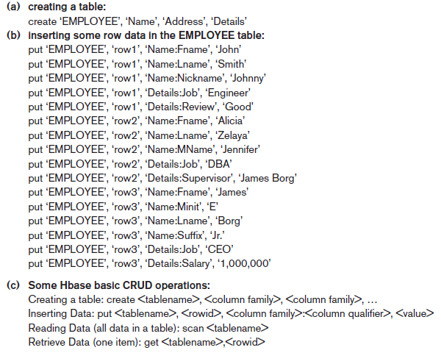

Slide 51
Hbase CRUD Operations
Provides only low-level CRUD (create, read, update, delete) operations
Application programs implement more complex operations
Create
Creates a new table and specifies one or more column families associated with the table
Put
Inserts new data or new versions of existing data items

Slide 52
Hbase CRUD Operations
Get
Retrieves data associated with a single row
Scan
Retrieves all the rows

Slide 53
Accessing Hbase
Hbase shell
Java API
Wrappers for Python, Scala, etc
Spark, Hive, Pig
REST Service
Thrift Service
Avro Service

Slide 54
External Data Storage
Data might be exposed to other systems
MySQL
MongoDB
Cassandra

Slide 55
Query Engines
External tools to interactively enter SQL queries
Apache Drill
Write SQL to diverse data stores (S3, HDFS, NoSQL) and unify them
Hue (Hadoop User Experience)
Equivalent to Ambari on Hortonworks
Apache Phoenix
Similar to Drill, guarantees RDBMS behavior on NoSQL database
Presto
Can talk to Cassandra, optimized for OLTP
Apache Zepplin
Web interface for a notebook type UI

Slide 56
MapReduce: Additional Details
MapReduce “Runtime”
Handles scheduling
Handles “data distribution”
Handles synchronization
Handles errors and faults

Slide 57
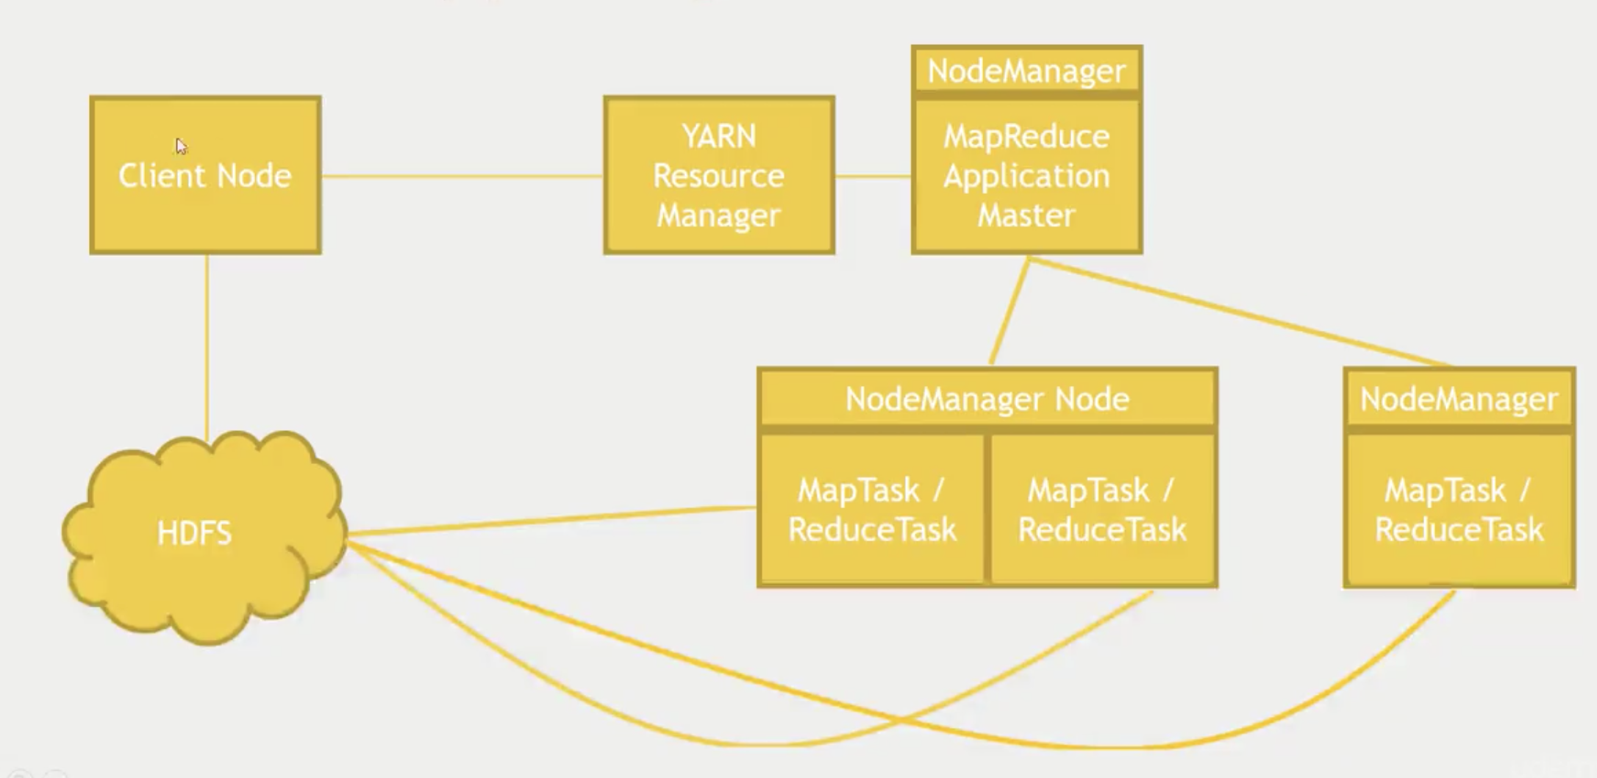

Slide 58
MapReduce: Additional Details
MapReduce runtime environment
JobTracker
Master process
Responsible for managing the life cycle of Jobs and scheduling Tasks on the cluster
TaskTracker
Slave process
Runs on all Worker nodes of the cluster

Slide 59
MapReduce: Additional Details
Overall flow of a MapReduce job
Job submission
Job initialization
Task assignment
Task execution
Job completion

Slide 60
MapReduce: Additional Details
Fault tolerance in MapReduce
Task failure
Runtime exception
Java virtual machine crash
No timely updates from the task process
TaskTracker failure
Crash or disconnection from JobTracker
Failed Tasks are rescheduled
JobTracker failure

Slide 61
MapReduce: Additional Details
MapReduce Handling Failure
Application master monitors worker tasks for errors or hanging
Restarts as needed
Application master down
YARN will try to restart it
Whole node goes down
Resource manager will try to restart it
Resource Manager goes down (BAD!)
Can setup HA (High Availability) using Zookeeper to have a standby node

Slide 62
Advantages of the Hadoop/MapReduce Technology
Disk seek rate a limiting factor when dealing with very large data sets
Limited by disk mechanical structure
Transfer speed is an electronic feature and increasing steadily
MapReduce processes large datasets in parallel
MapReduce handles semistructured data and key-value datasets more easily
Linear scalability

Slide 63
Challenges of Big Data Technology
Heterogeneity of information
Privacy and Confidentiality
Need for visualization and better human interfaces
Inconsistent and incomplete information

Slide 64
Hadoop in Cloud Computing
Big data somewhat dependent on cloud technology
Cloud model offers flexibility
Scaling out and scaling up
Distributed software and interchangeable resources
Unpredictable computing needs not uncommon in big data projects
High availability and durability

Slide 65
Hadoop in Cloud Computing
Amazon EMR (Elastic Map Reduce)
Provides managed Hadoop platform
Easy to use
Pay hourly
Elastic (add/remove capacity)
Less monitoring
Secure
Flexible
Can use other popular frameworks (Spark)

Slide 66
Hadoop in Cloud Computing
Amazon EMR Use Cases
Web log processing
Clickstream analysis
Product recommendation engine
Scientific simulations
Data transformations
ETL (extract, transform, load)
Move data between DynamoDB, Redshift, S3, etc

Slide 67
LAB 1 – Part I
Launch EC2 instance
Amazon Machine Image (AMI)
Set of predefined software configuration and applications
Instance = virtual machine launched on AWS
Can chose network
Availability zone
IAM role

Slide 68
LAB 1
EC2 has several predefined capacity packages that you can chose to launch an instance with
Instance types are defined and categorized based on:
CPU
Memory
Storage
Network Capacity

Slide 69
LAB 1
Each instance type includes multiple instance sizes
Three main ones:
General Purpose: M3
Memory optimized: R3
Compute Optimized: C3

Slide 70
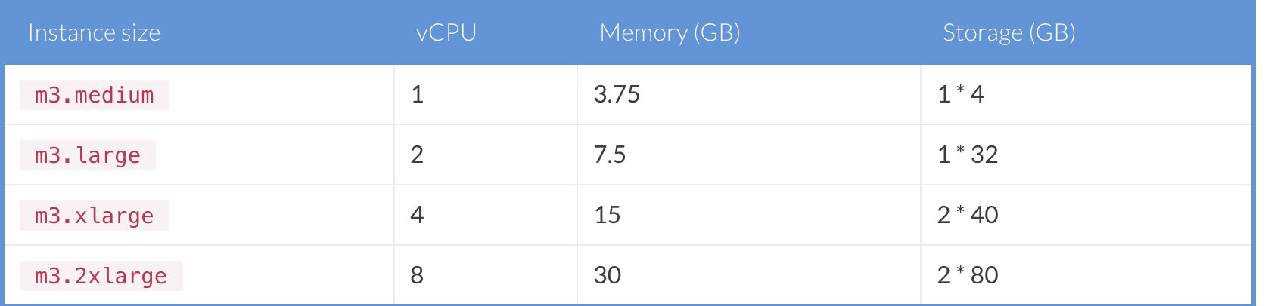
LAB 1
M3 Instance types:

Slide 71
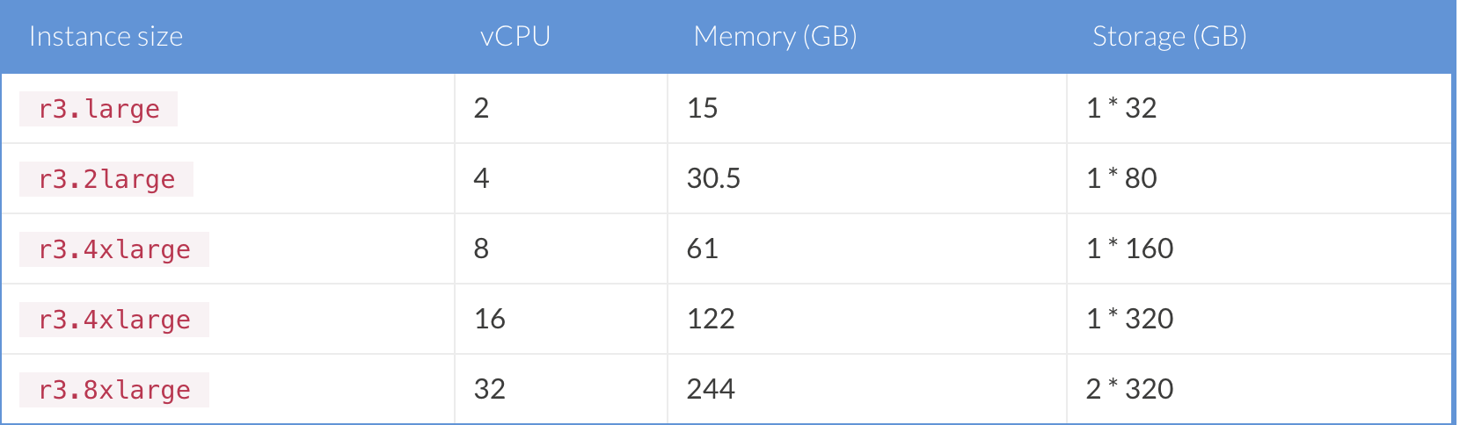
LAB 1
R3 Instance types:

Slide 72
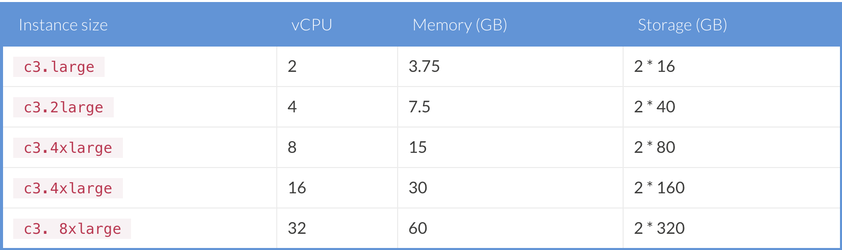
LAB 1
C3 Instance types:

Slide 73
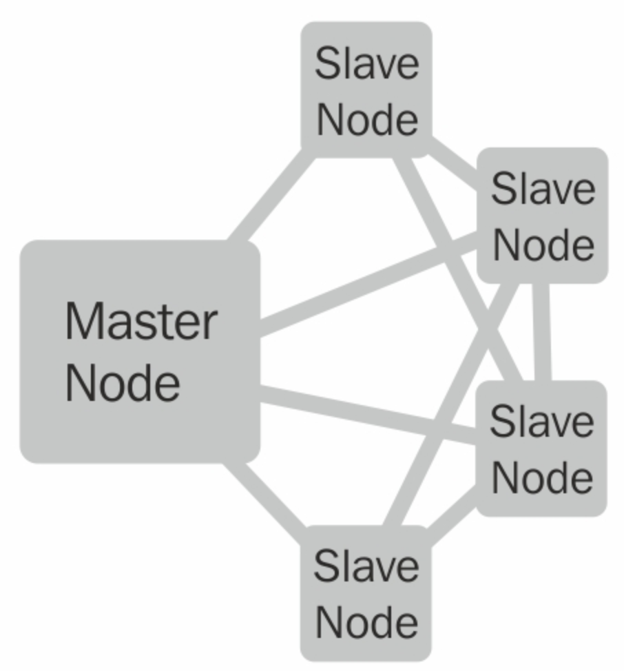
LAB 1 – Part II

Slide 74
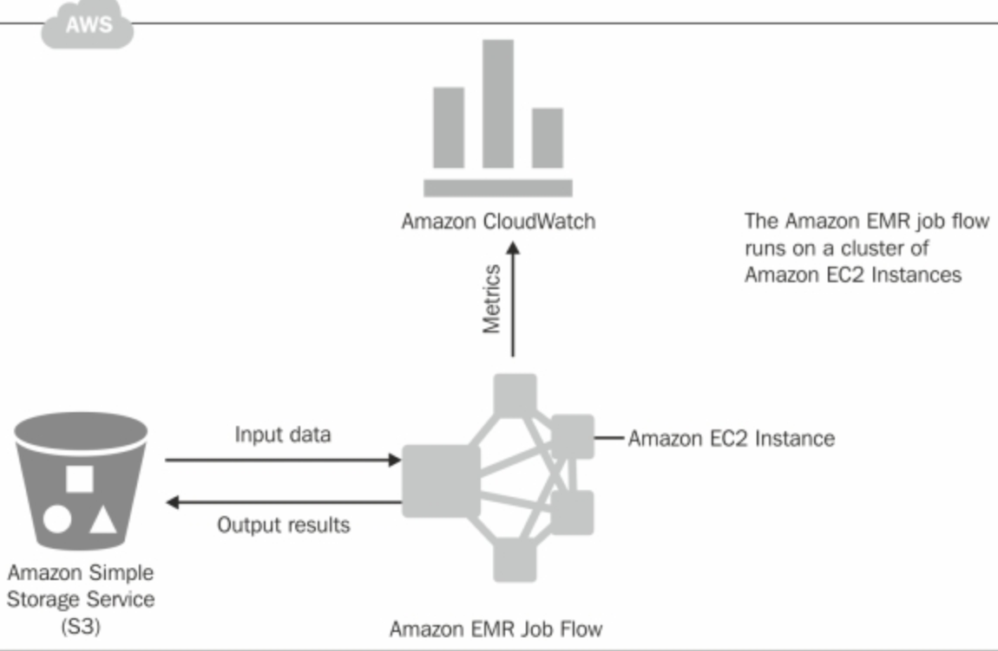
LAB 1 – Part II

Slide 75
LAB 1 – Part II
Amazon EMR provides three different roles for the nodes
Master node
Controls and manages cluster
Core nodes
Execute MapReduce tasks
Task nodes
Used for only MapReduce task execution and are optional

Slide 76
LAB 1 – Part II
EMR Job Flow and Steps
User-defined action for executing a set of related Job Steps using EMR cluster
Job Flow consists of one or more steps
Job steps (unit of work, applies one of these types)
Custom JAR
Streaming program
Hive or Pig program

Slide 77
LAB 1 – Part II
Let’s say we want to perform web access log processing
Job Step 1: Provides access and cleans the input logs
Job Step 2: Analyzes logs after cleaning by URL, HTTP status code and IP address
Job Step 3: Creates summary reports based on URL’s, HTTP status codes, or IP addresses.

Slide 78
LAB 1 – Part II
At any given point of time in a lifecycle of Job Step
RUNNING
COMPLETED
PENDING
FAILED
CANCELED

Slide 79
LAB 1 – Part II
EMR provides three choices:
Continue
Cancel and wait
Terminate cluster

Slide 80
LAB 1 – Part II
EMR cluster may have these states:
STARTING
BOOTSTRAPPING
RUNNING
WAITING
SHUTTING_DOWN
TERMINATED
COMPLETED
FAILED

Slide 81
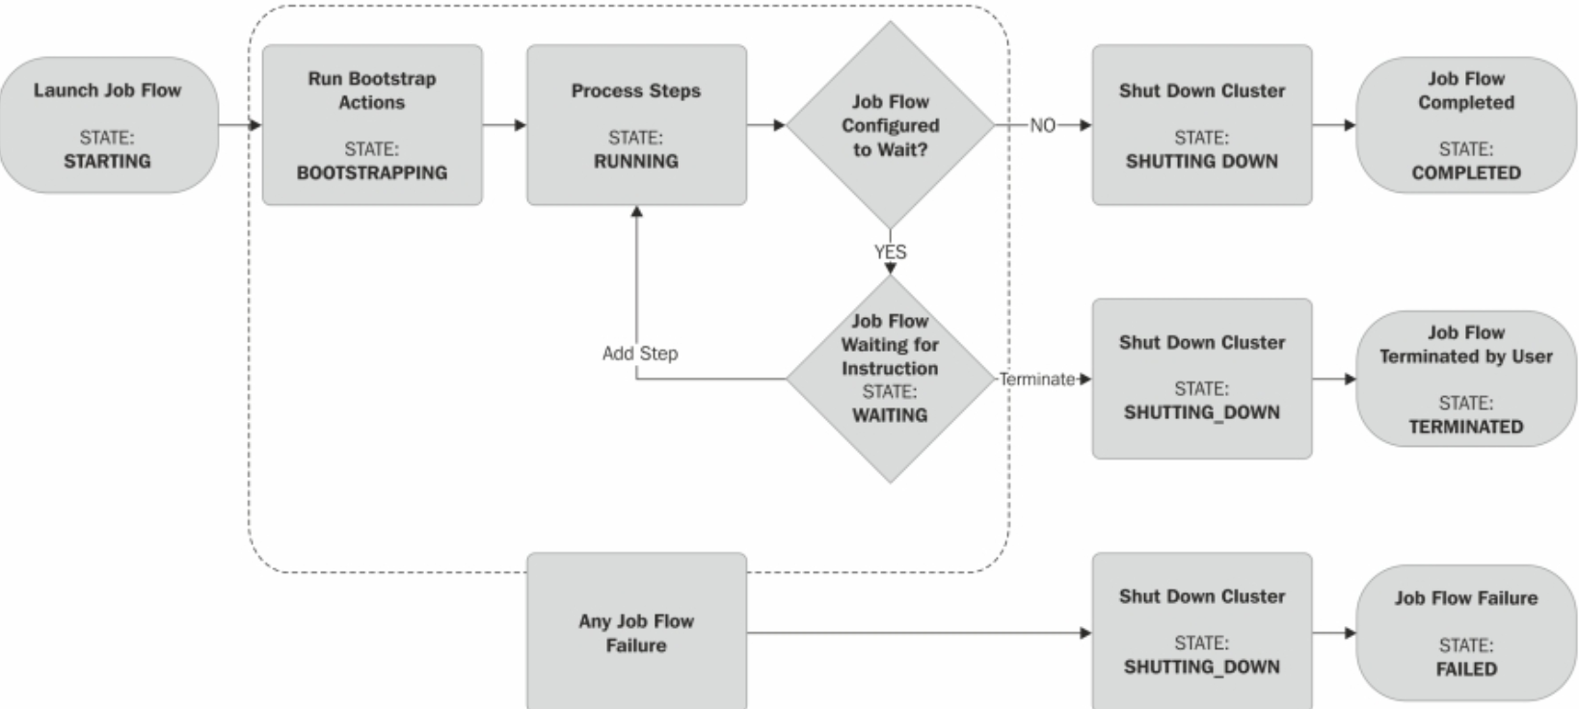
LAB 1 – Part II

Slide 82
LAB 1 – Part II
Hadoop file system on EMR:
EMR supports using AWS S3 or HDFS as filesystems
Can use S3 for input data to jobs and output data of the EMR cluster
If using S3 to store the input data, can run multiple clusters that perform different jobs on the same dataset
Can load input data to jobs from S3 into HDFS for job execution

Slide 83
Sources
“Fundamentals of Database Systems”
“Ultimate Hands-on Hadoop”
“Learning Big Data with Amazon Elastic MapReduce”
“Hadoop ecosystem and their components – a complete tutorial”

